Slide 1
Reading materials
Read chapter : Dynamic Programming from Reinforcement Learning – Sutton and Barto : https://www.andrew.cmu.edu/course/10-703/textbook/BartoSutton.pdf [This is not an open book, but available online]
Read Chapter : Planning and Learning with Tabular Methods till section 8.3 from Reinforcement Learning – Sutton and Barto : https://www.andrew.cmu.edu/course/10-703/textbook/BartoSutton.pdf [This is not an open book, but available online]

Slide 2
AlphaGo versus Lee Sedol

Slide 3
Planning and Learning with Tabular Methods
Integrating Model-Based and Model-Free methods :
Model-free reinforcement learning refers to methods where the agent learns directly from interactions with the environment without a model of the environment's dynamics. The agent learns policies or value functions based solely on observed rewards and state transitions. The agent does not construct or use a model of the environment.
Model-based reinforcement learning involves building a model of the environment's dynamics. The agent uses this model to simulate experiences and make decisions. There are two primary components:
Model Learning: The agent learns a model of the environment that predicts the next state and reward given the current state and action.
Planning: The agent uses the learned model to simulate and evaluate potential future actions to choose the best policy.
We will be using multiarmed bandit example to describe model free and model-based methods and next lectures will be based on the subcategories of Model based and Model free learning.

Slide 4
Model-Free Learning Example
In a model-free approach, the agent does not care about the underlying "why" or the specific probability
distributions of the machines. It simply maps actions directly to expected rewards based on experience.
The Logic: "When I pulled Arm A, I got 10 points. I'll increase my 'score' for Arm A.“
The Tool: Action-Value Methods (greedy method).
The Process:
The agent maintains an estimate $Q(a)$ for each arm.
It pulls Arm A and receives reward $R$.
It updates the value using a simple error correction formula:
Q_{new}(A) → Q_{old}(A) + α[R - Q_{old}(A)]
The agent chooses the next arm based solely on which $Q$ value is currently highest (with occasional random exploration).
Analogy: You go to a restaurant and try the pasta. It’s great, so you give the restaurant a "5-star"
rating in your head. You don't know the recipe or who the chef is; you just know "Pasta = Good."

Slide 5
Model-Based Learning Example
In a model-based approach, the agent attempts to build an internal representation (a model) of how each arm behaves.
It treats the reward as a parameter to be estimated.
The Logic: "I believe Arm B follows a Gaussian distribution with a mean and variance. Based on my 5 pulls, I will update my model of its probability density function."
The Tool: Thompson Sampling or Bayesian Bandits.
The Process:
The agent starts with a Prior (e.g., "I assume all arms have a 50/50 chance of paying out").
It pulls Arm B and observes the outcome.
It updates the Model: It uses Bayes' Theorem to update the probability distribution for Arm B.
Planning/Inference: Before the next pull, the agent "simulates" the arms by drawing samples from its internal models
and picks the one that performs best in the simulation.
Analogy: You look at the restaurant’s kitchen. You notice the chef uses fresh ingredients on Tuesdays but frozen ones on Fridays.
You build a model: $P( {Quality} |{Day})$. You then plan your visit based on that model.

Slide 6
Grid World or Maze scenario :
Model-Free Maze Solving (Direct RL)In a model-free approach, the agent learns the maze solely through real experience.
Process: The agent moves through the actual maze, observing a state, taking an action, and receiving a reward/next state.
Model-Based Maze Solving (Planning)A model-based agent uses a model of the maze to generate simulated experience.
Process: The agent builds an internal "map" (model) of which actions lead to which states.
Now let's take a look at another example – you tell me which approach will be better for the next example : Model free or Model Based and why ? Discuss Pros and Cons.

Slide 7
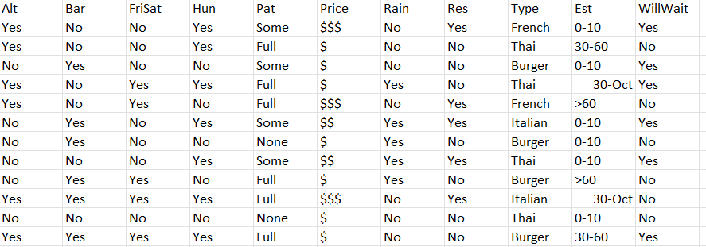

Slide 8
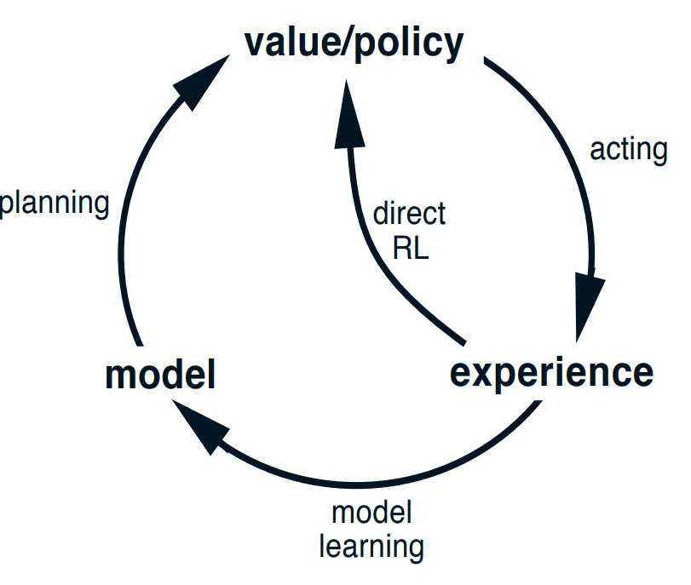
Is a unified model possible ?
Dyna-Q : Integrated Planning, Acting, and Learning
When can a model go wrong ?

